Slide 1

SQL Project (Analyzing TMDB Top Rated Movies Using SQL)

Slide 2
Project overview
"In this project, I worked with the TMDB Top Rated Movies dataset, performing various SQL operations such as creating a database, renaming the table, deleting irrelevant columns, and running complex queries to extract useful insights."

Slide 3

Task To be Performed
Creating database
Changing the table name
Deleting irrelevant columns
Retrieve all movies sorted by rating (descending) based on popularity.
Retrieve movies with a popularity greater than 8:
Count the number of movies in each genre:
Find the total vote count of all movies:
top 3 movies on basis of vote count and the language is English
Find the most common movie language:

Slide 4

Dataset Description
Total rows 21 and Total Columns 10
The TMDB dataset contains the following columns:
• id: Unique identifier for each movie
• title: Movie title
• original_language: Language of the movie
• release_date: Date of release
• vote_average: Average user rating
• vote_count: Number of votes
• popularity
• overview
• genre_ids
• Genres

Slide 5
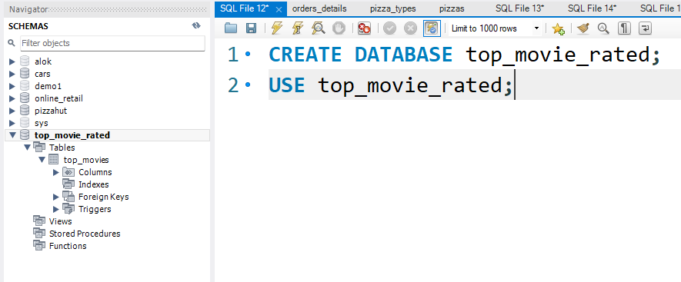
1.Database creation
"First, I created a database to organize the movie data

Slide 6
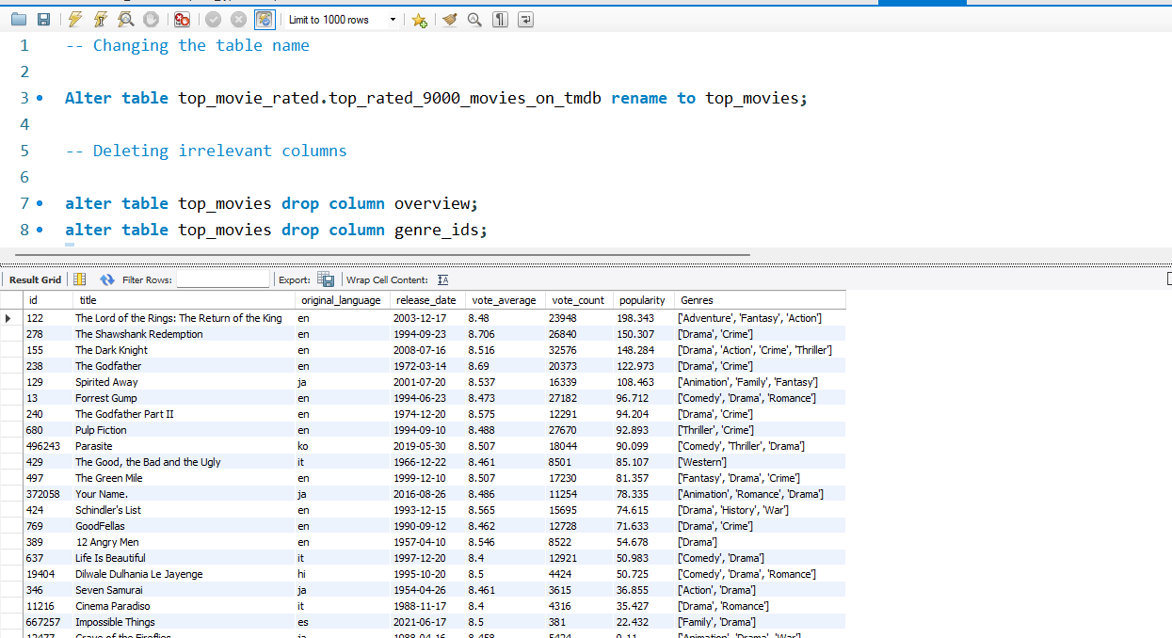
2. Changing the table name and Deleting irrelevant columns
“ Here I renamed the table to top_movies for better clarity. I then removed unnecessary columns like genre_ids and overview to focus on important details such as original_language, genres, popularity, and vote counts."

Slide 7
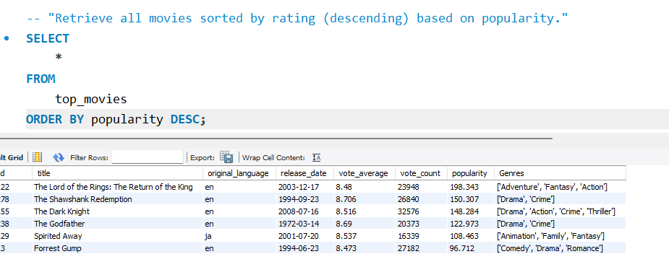

3.Retrieve all movies sorted by rating (descending) based on popularity.
"Next, I ran a query to sort movies by rating in descending order, with popularity as a backup filter. As expected, top-rated films like *The Lord of the Rings: The Return of the King* and *The Shawshank Redemption* ranked highest. This shows that highly rated movies are usually popular, confirming that good ratings often mean high audience engagement."

Slide 8
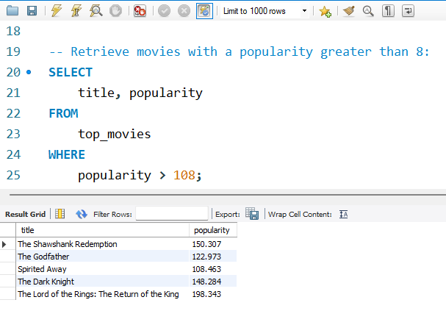

4. Retrieve movies with a popularity greater than 8:
"I then looked at movies with a popularity score above 8. Many popular films, like *The Shawshank Redemption* and *The Godfather* Ire found. This shows that top-rated movies not only get good reviews but are also Ill-liked by the public, getting lots of attention and interaction."

Slide 9
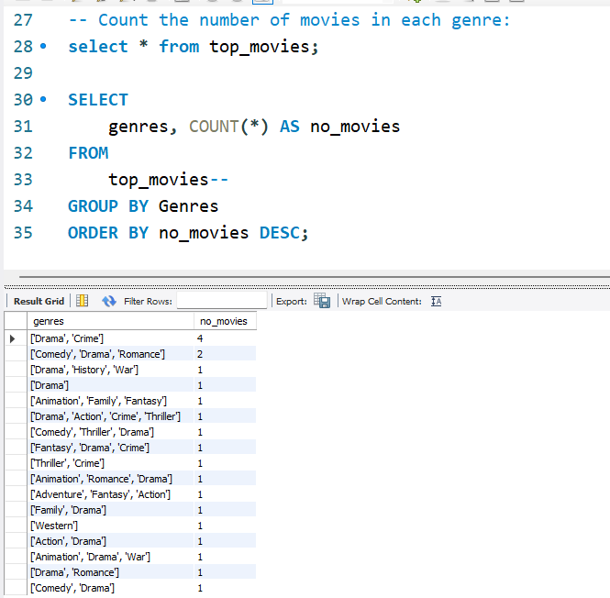
5. Count the number of movies in each genre:
"I also analyzed the genres to count how many movies belong to each one. The results shoId that Drama and Crime are the most common genres. This makes sense because these genres usually attract larger and more varied audiences, leading to more movies being made and more people watching them."

Slide 10
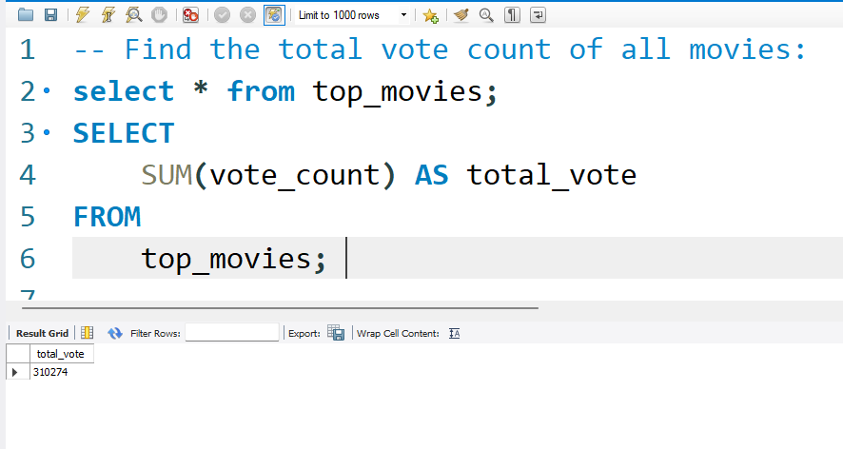
6. Find the total vote count of all movies:

Slide 11
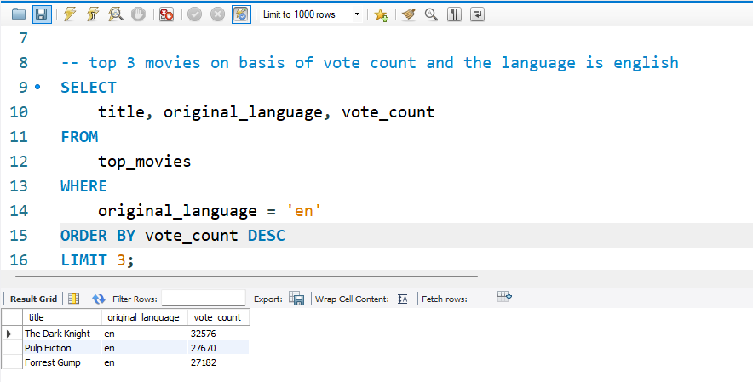
7. top 3 movies on basis of vote count and the language is english
"To explore user engagement, we examined the top 3 English movies by vote count. As expected, The Dark Knight, Pulp Fiction, and Forrest Gump were at the top. This shows that English-language films, especially popular ones, attract a lot of attention from viewers worldwide."

Slide 12
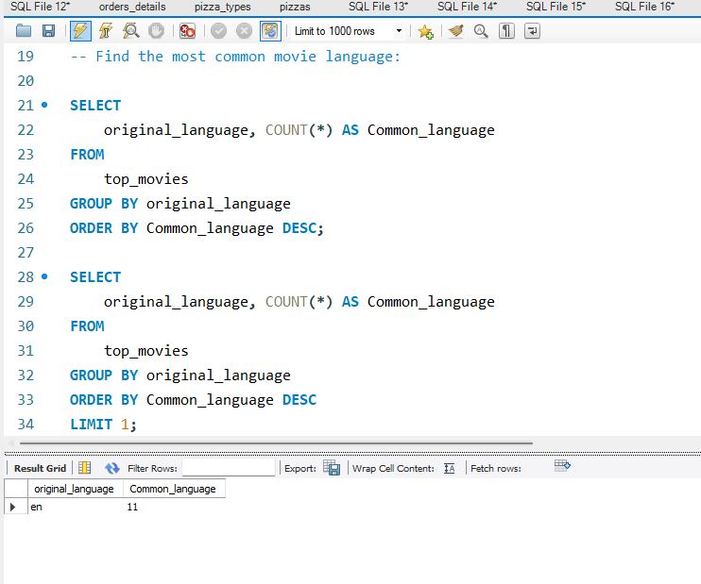
8. Find the most common movie language:
"Finally, we found that English is the most common language in the top-rated movies. This shows Hollywood's strong influence and how widely English films are shared around the world, highlighting their importance in global cinema."

Slide 13
Conclusion
The SQL analysis of the TMDB Top Rated Movies dataset revealed several key insights. Movies with high ratings often correlate with high popularity, with films like lord of the rings and The Shawshank Redemption standing out. The crime and Drama genres dominate the dataset, while English is the most common language, reflecting Hollywood’s global influence. Additionally, a significant portion of the movies have a popularity score greater than 8, and the total vote count indicates strong audience engagement. These findings highlight the factors contributing to a movie's success in terms of popularity, genre, and language.

Slide 14
Thankyou

